Slide 1
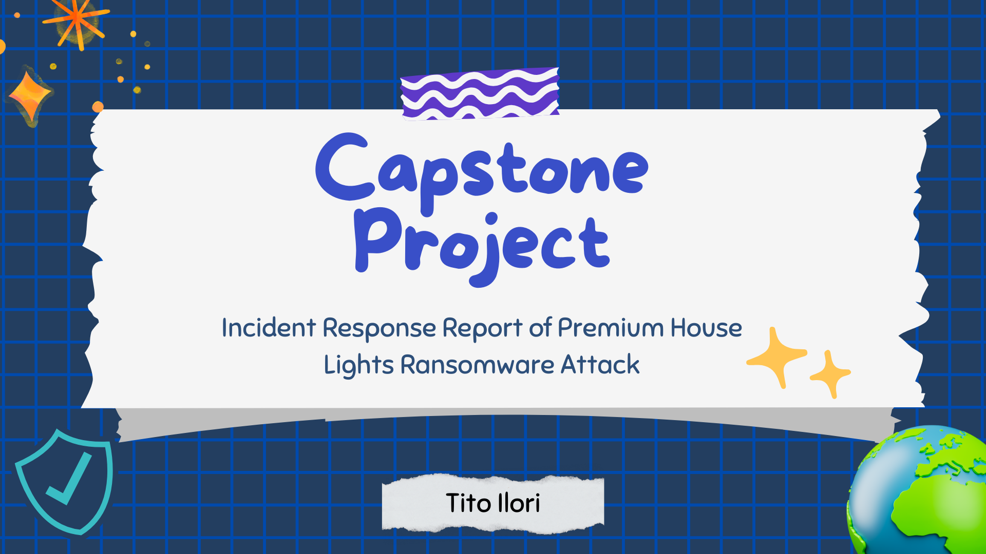
LHL Cyber Bootcamp, June 26 cohort
Notes:
Hello everyone. My Name is Tito Ilori, a graduating student of June 2023 Cohort. I will be presenting my Capstone Project which is an Incident response report of a Ransomware Attack at Premium House Lights Company.

Slide 2
ABOUT ME:
"It takes 20 years to build a reputation and a few minutes of cyber-incident to ruin it."
- Stephane Nappo
Background: Bachelor's degree in Microbiology
Over 7-year IT experience with Interest in Secure Cloud Computing.
CompTIA Security+ and (ISC)² CC
AWS SAA (by Oct 2023) and ISACA’s CISM (in 2023)
Skilled with hands-on experience with IT languages and tools, network protocols and more.
Love solving problems, a team player and detail oriented
Hobbies: Doing Music and Watching Sci-Fi Movies
https://www.linkedin.com/in/tito-ilori-dm/
Notes:
Before I start, a little about me! I love this quote by Stephane that says "It takes 20 years to build a reputation and a few minutes of cyber-incident to ruin it."
Though I have a background in Microbiology, I have strong Interest in Secure Computing which made me got Professionally certified with CompTIA Sec+ and ISC2 CC. I am also currently preparing for these other certifications.
I love solving problems, I’m a team player and I’m detail-oriented. I also love music and watching Sci-Fi movies.
Enough said about me. Now I will love to briefly walk you through my report by telling a story.

Slide 3
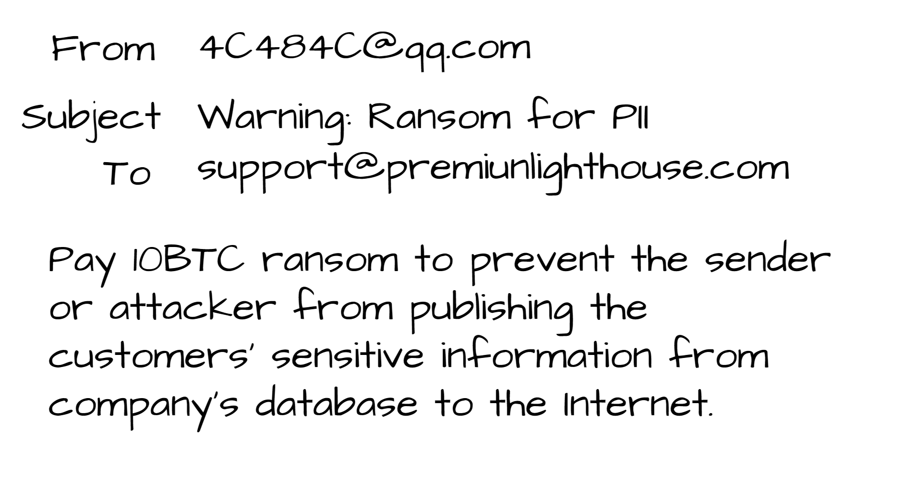






Tuesday morning
https://www.linkedin.com/in/tito-ilori-dm/
Notes:
It’s a BEAUTIFUL Tuesday morning, February 22nd, 2022 *** after grabbing my favorite French vanilla coffee. I resumed to my work desk, and I found an e-mail.
It’s an extortion email in the company support mailbox asking for 10 BTC ransom to prevent the sender or the attacker from publishing the customers sensitive information gotten from PHL’s database on the Internet.
As a cybersecurity specialist, I began to triage the incident by collecting the logs and network telemetry available on the web server and database server. took the captures to VS code and Wireshark to analyse the incident.

Slide 4







MY FINDINGS
- - - -
4’ 32”
Database
Web server
CVE-2020-1927
Production VLAN
https://www.linkedin.com/in/tito-ilori-dm/
Notes:
here are my findings.
** There appears to be an unauthorized access in the network that lasted for 4mins 32 seconds
** - From this findings, the intruder or attacker exploited the webserver that has known vulnerabilities as follows.
** - One, the public-facing webserver is within the same local network with the database server.
Two, the server only has the HTTP port open, which has unencrypted means of communication.
Three, the web server uses an outdated Apache application that enable bad actors to run code by simply encoding newlines to send request to the server
This was reported in NIST National Vulnerability Database. The attacker exploited this weakness and performed a wordlist reconnaissance, sending multiple requests to the webserver to know what directory and files are present on the server.

Slide 5



MY FINDINGS
=
=
Telnet
Database
Web server
https://www.linkedin.com/in/tito-ilori-dm/
Notes:
The intruder discovered a web shell, which can be exploited to gain Command and Control remotely.
It executed a python script to establish a reverse shell for remote command execution.
** Using the interactive shell, the attacker performed a lateral movement into the database using Telnet, another non-secure communication protocol, and escalating privileges into the database, guessing the credential combinations.

Slide 6
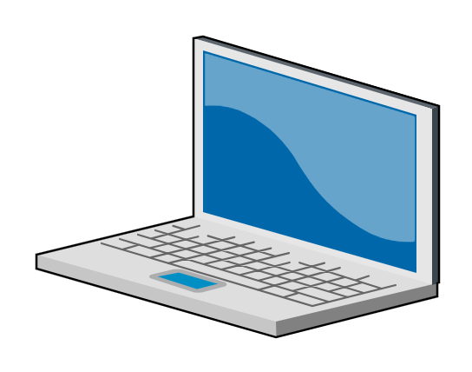
MY FINDINGS
Remote server
Database
https://www.linkedin.com/in/tito-ilori-dm/
Notes:
THE ATTACKER IS NOW READY TO STEAL. It explored the MySQL monitor on the database and found where the sensitive information of the customers was stored,
copied the data in a database file and sent it to a remote server.
It then deleted the file to erase its fingerprint on the database server and exited.

Slide 7






MY recommendations
NETWORK SEGMENTATION
PATCH MANAGEMENT
DATA ENCRYPTION
STRONG PASSWORD & MULTI-FACTOR AUTHENTICATION
INTRUSION DETECTION AND MONITORING
DEVELOP INDUSTRY STANDARD POLICIES
https://www.linkedin.com/in/tito-ilori-dm/
Notes:
Here are my recommendations to improve the security posture of the company.
Implement Network Segmentation by creating a DMZ for the webserver.
Implement regular patch management practices for system updates
Execute adequate data encryption
Use strong passwords and MFA
Use Monitoring and Intrusion Detection tools.
Develop industry standard policies using OWASP 10, CIS, NIST and ISO 27001 recommendations.

Slide 8

https://www.linkedin.com/in/tito-ilori-dm/
Notes:
If you have any questions, let’s connect on LinkedIn.
Thanks to Lighthouse Labs, all my instructors, all mentors and my amazing colleagues.
Thank you all for listening.

